Slide 1

James Paul
Competency Portfolio
www.infratec-uk.com

Slide 2
Competency Summary
Category | Accreditation Body | No. | Expiry
Emergency First Aid at Work Lvl 3 | Qualsafe Awards | 2893021 | 30/08/2025
Safe Moving and Handling | Qualsafe Awards | 2898564 | 30/08/2025
IPAF 1b Static Boom | IPAF | OP/2210515 | 30/09/2027
Highway Electrical Registration Scheme (HERS) | CSCS | H1188385 | 03/10/2025
Working at Height Level 2 (RQF) | QualSafe Awards | 3021034 | 15/02/2026
Confined Space Safe Entry & Self Rescue | IIRSM | CS-02 10058 | 12/02/2026
National Highways Safety Passport | National Highways | 14-00045071 | 17/02/2026
Counterbalance Forklift Truck | A1 Forklift | TH5521 | 24/05/2029
Slinger / Signaller | ALLMI | 67169 | 19/10/2028
www.infratec-uk.com

Slide 3
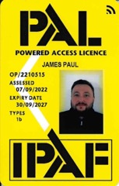
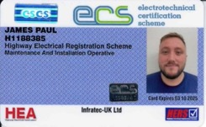

Competency Cards
IPAF
HERS
National Highways
www.infratec-uk.com

Slide 4
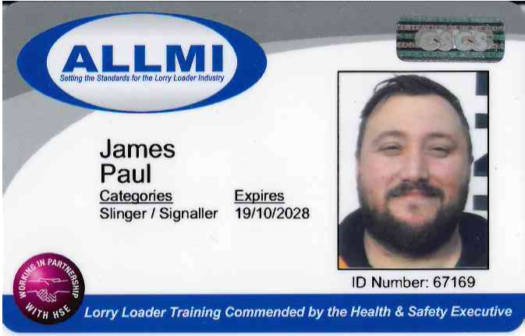
Competency Cards
ALLMI
www.infratec-uk.com

